Slide 1



College Fest Management System
Group no : 43
Presented By :
Shivam H. Sonani [194]
Minansh N. Sopariwala [195]
Divam M. Modi [112]
Sumit V. Goyal [049]
Guided By :
Prof. Jaimini patel

Slide 2
Personal Profile
Exam No | 194
Name | Shivam H. Sonani
Class | TY-BCA-SEM-5
Email | shivam1sonani@gmail.com
Phone No | 8200809321
Exam No | 195
Name | Minansh N. Sopariwala
Class | TY-BCA-SEM-5
Email | minansh07@gmail.com
Phone No | 7490007577

Slide 3
Exam No | 112
Name | Divam M.Modi
Class | TY-BCA-SEM-5
Email | divammodi777@gmail.com
Phone | 9724859795
Exam No | 49
Name | Sumit V. Goyal
Class | TY-BCA-SEM-5
Email | sumitgoyal0804@gmail.com
Phone | 8866741303

Slide 4
Overview
Event Planning and Coordination:
A college fest management system helps entire process of planning, scheduling, and coordinating various events within the fest, ensuring smooth organization.
Participant Registration:
It enables online registration for students and external participants, tracking participation in various competitions, and events, reducing manual errors.
Event Scheduling and Notifications:
The system provides real-time updates, scheduling, and notifications for events, ensuring participants and organizers are aware of any changes or updates.

Slide 5
Overview
Volunteer and Resource Management:
Manages the allocation of volunteers, event coordinators, and other human resources, optimizing their roles and responsibilities for efficient fest execution
Event Participation:
Provides detailed analytics on event performance, participation, and feedback from attendees, helping improve future fest planning.

Slide 6
Introduction
Centralized Management:
This system provides a comprehensive platform for managing various participation records, admin management, and more, from a single system.
Automation of Processes:
It automates routine processes such as event management, reducing manual efforts and increasing efficiency.
Improved Communication:
The system enhances communication between Event Organizer and participants through integrated messaging, notifications, and alerts for important updates.
.

Slide 7
Introduction
Data Security and Access Control:
It ensures secure storage of sensitive data like participation information, volunteers records, and participation details, with controlled access to authorized personnel only.
Real-Time Monitoring and Reporting:
The system provides real-time tracking of event along with detailed reporting for better decision-making.

Slide 8

Analysis and Planning
Requirement Gathering:
Identify the needs of students, faculty, and administrators, to determine the core functionalities the system must support.
System Architecture Design:
Plan the architecture of the system, defining modules, database structure, user interfaces, and system integrations to ensure scalability and efficiency.
Timeline and Milestone Planning:
Establish a clear timeline with key milestones for development, testing, deployment, and user training, ensuring smooth execution of the project.

Slide 9

MODULES AND FEATURE
Club Management
Event Management
User Management
Participation Module
Volunteer Module

Slide 10








Technology Used
• HTML is used to structure and display content on the web pages. It defines the layout of the user interface, including text, images, forms, tables, and links, providing the foundation for the website.
PHP is used for backend development and server-side scripting. It handles the business logic of the system, processes data from the database, manages user sessions, and handles form submissions.
PHP works with databases like MySQL to store and retrieve data efficiently. The database is essential for managing user records, course details, exam results, fee records, and other system data.
Bootstrap is a responsive front-end framework that simplifies designing the user interface. It provides pre-built components like buttons, navigation bars, modals, and forms, ensuring a consistent look across all devices.

Slide 11
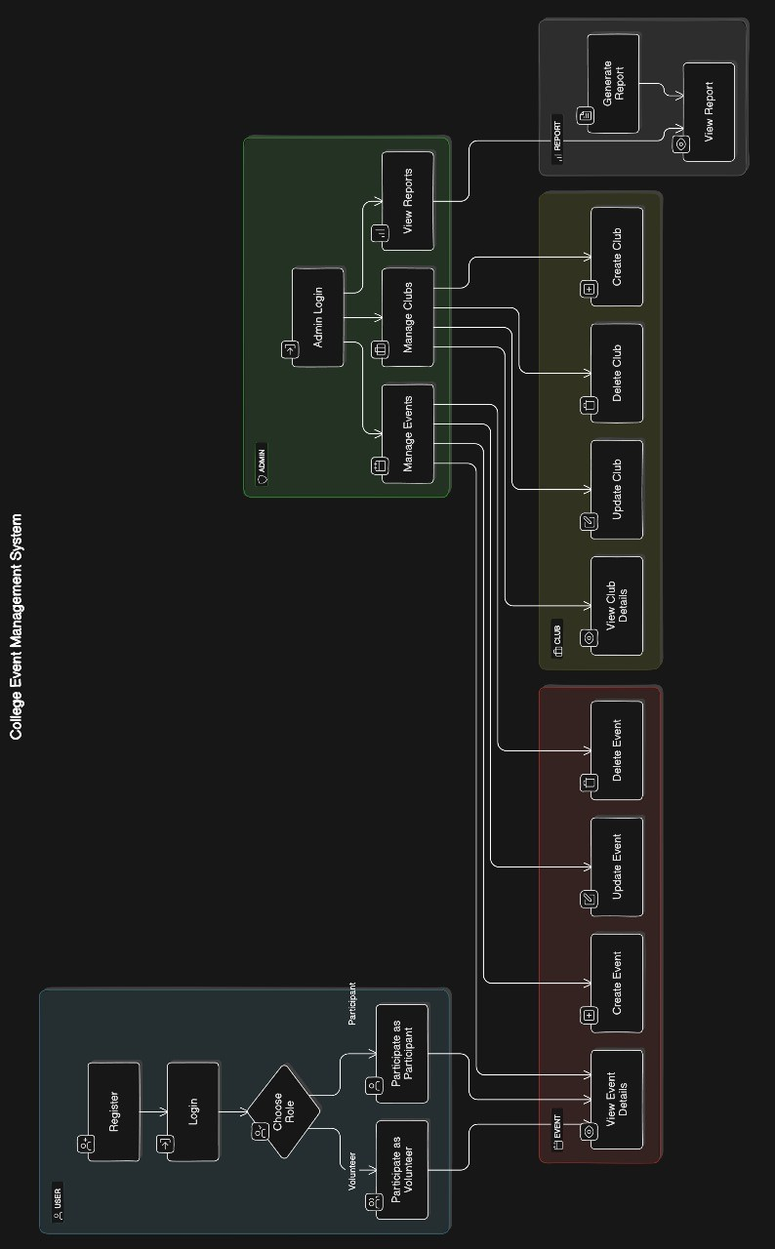
Data Flow Diagram

Slide 12
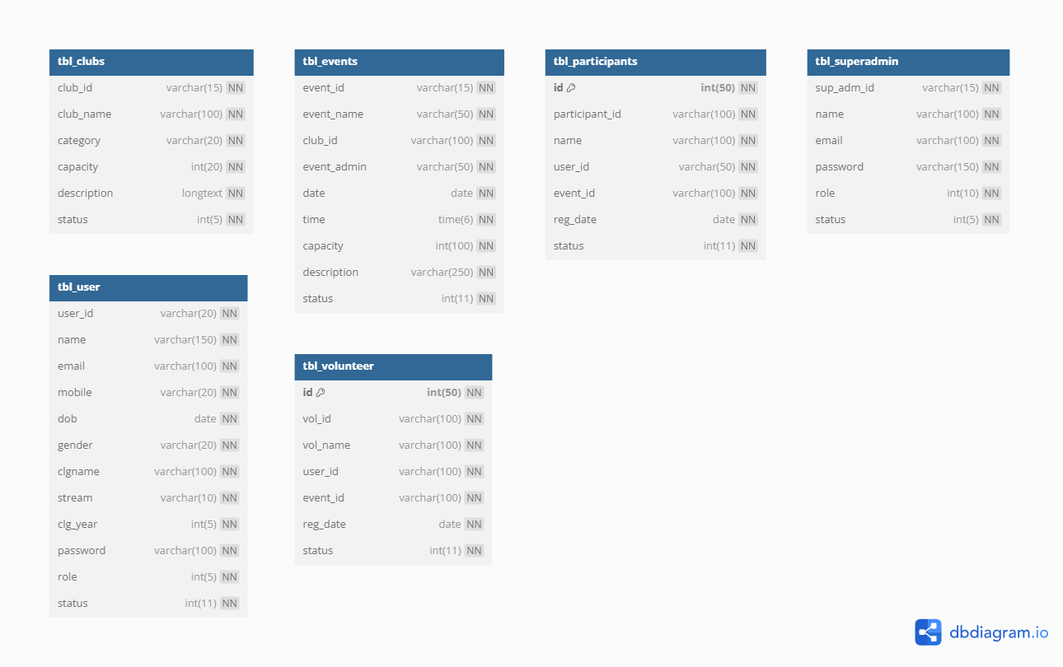
Database Design

Slide 13
CONCLUSION
Streamlined Event Coordination:
Simplifies complex organizational tasks.Ensures all event activities are well-coordinated and efficiently managed.
Enhanced Communication
Facilitates seamless communication among students, faculty, and participants.Provides real-time updates and notifications to keep everyone informed.
Improved Efficiency:
Automates registration, scheduling, and other administrative tasks.Reduces the manual workload and chances of errors.

Slide 14
CONCLUSION
Better Collaboration:
Encourages teamwork and collaboration among organizing committees.Integrates various stakeholders, fostering a cooperative environment.
Real-Time Updates:
Keeps everyone updated with the latest information.Ensures smooth execution of events without any last-minute hiccups.

Slide 15
THANK YOU

